Slide 1
Analyzing Amazon Sales data

Slide 2
Introduction
This project analyzes Amazon sales data through an ETL process, identifying monthly, yearly, and yearly-monthly sales trends. Key metrics and relationships are examined to provide actionable insights for improving sales performance and strategic decision-making.

Slide 3
Objective​
Sales management has gained importance to meet increasing competition and the need​
for improved methods of distribution to reduce cost and to increase profits. Sales​
management today is the most important function in a commercial and business​
enterprise.​
Benefits​
Help out to make better business decisions.​
Help analyze customer trends and satisfaction, which can lead to new and better products and services.​
Gives better insight of customers base.​
Helps in easy flow for managing resources.​
Problem Statement​
Develop a Report by Extracting-Transforming-Loading of data which contains Sales trend with respect to Year, Month, Quarter and find Some relationships through data to understand and Analyze the Facts.​

Slide 4
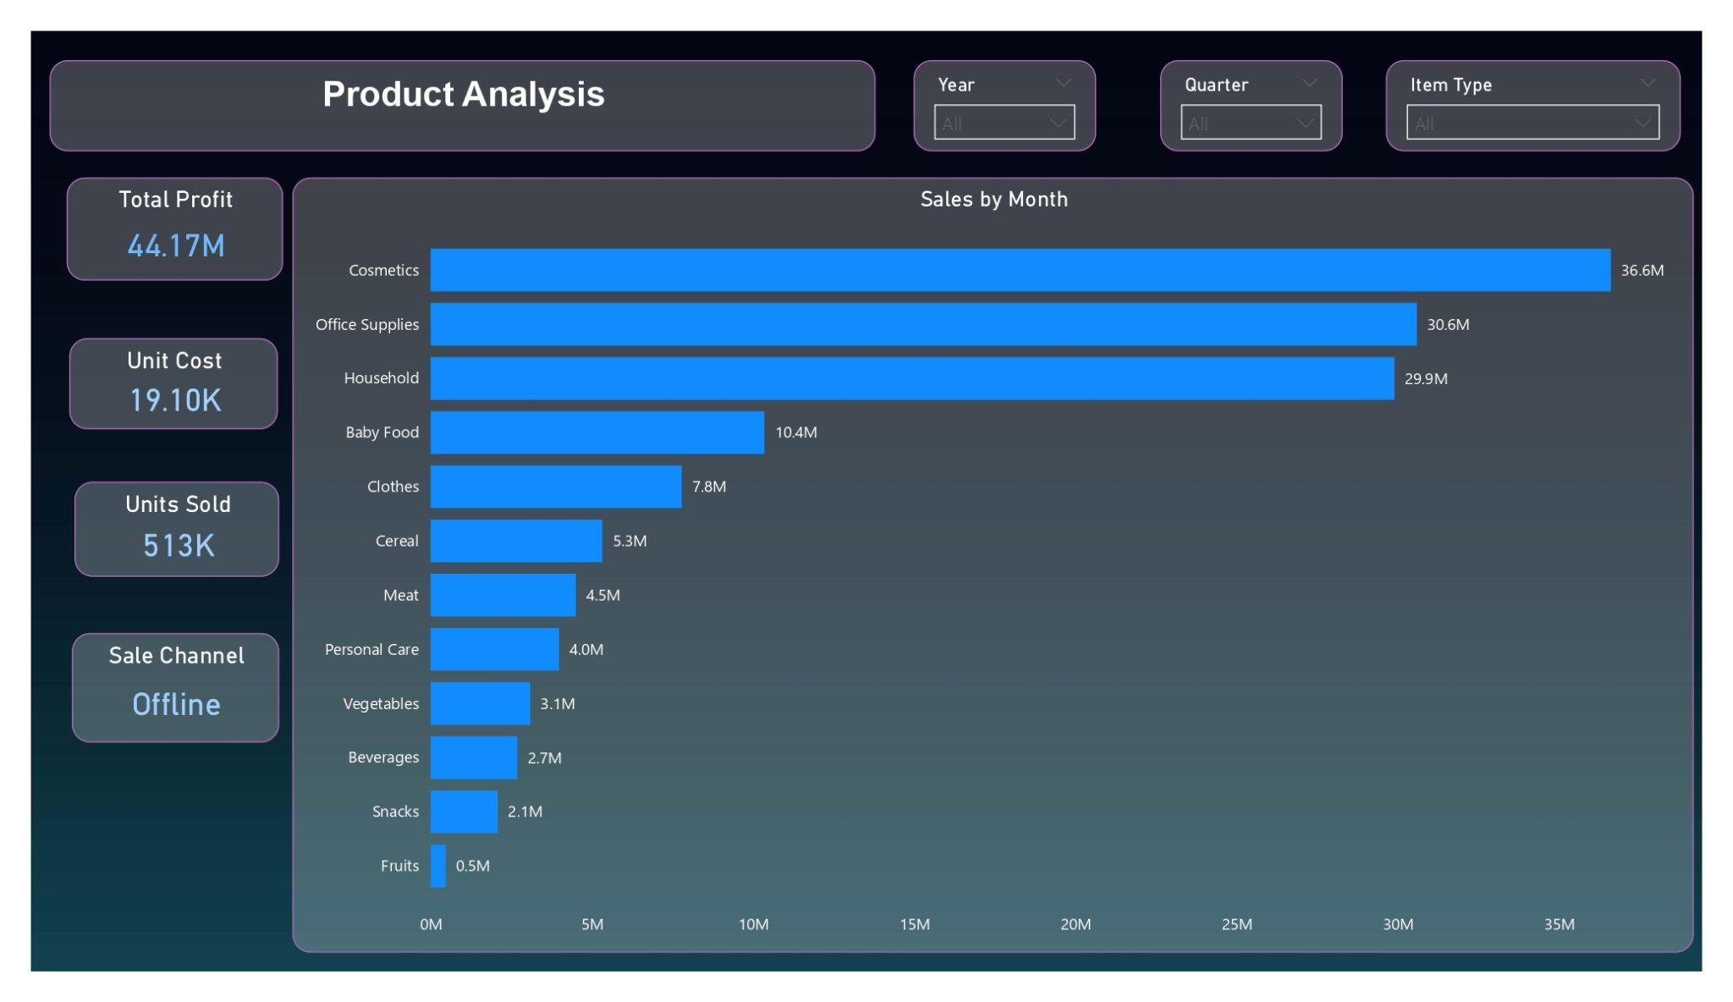
Details of Data

Slide 5
Main KPIs
Total Profit = Yearly profit including of every month and day.
Total Cost = The overall expense of unit price and the unit sold.
Total Revenue = It means No.of unit sold multiply by No.of cost per unit.

Slide 6
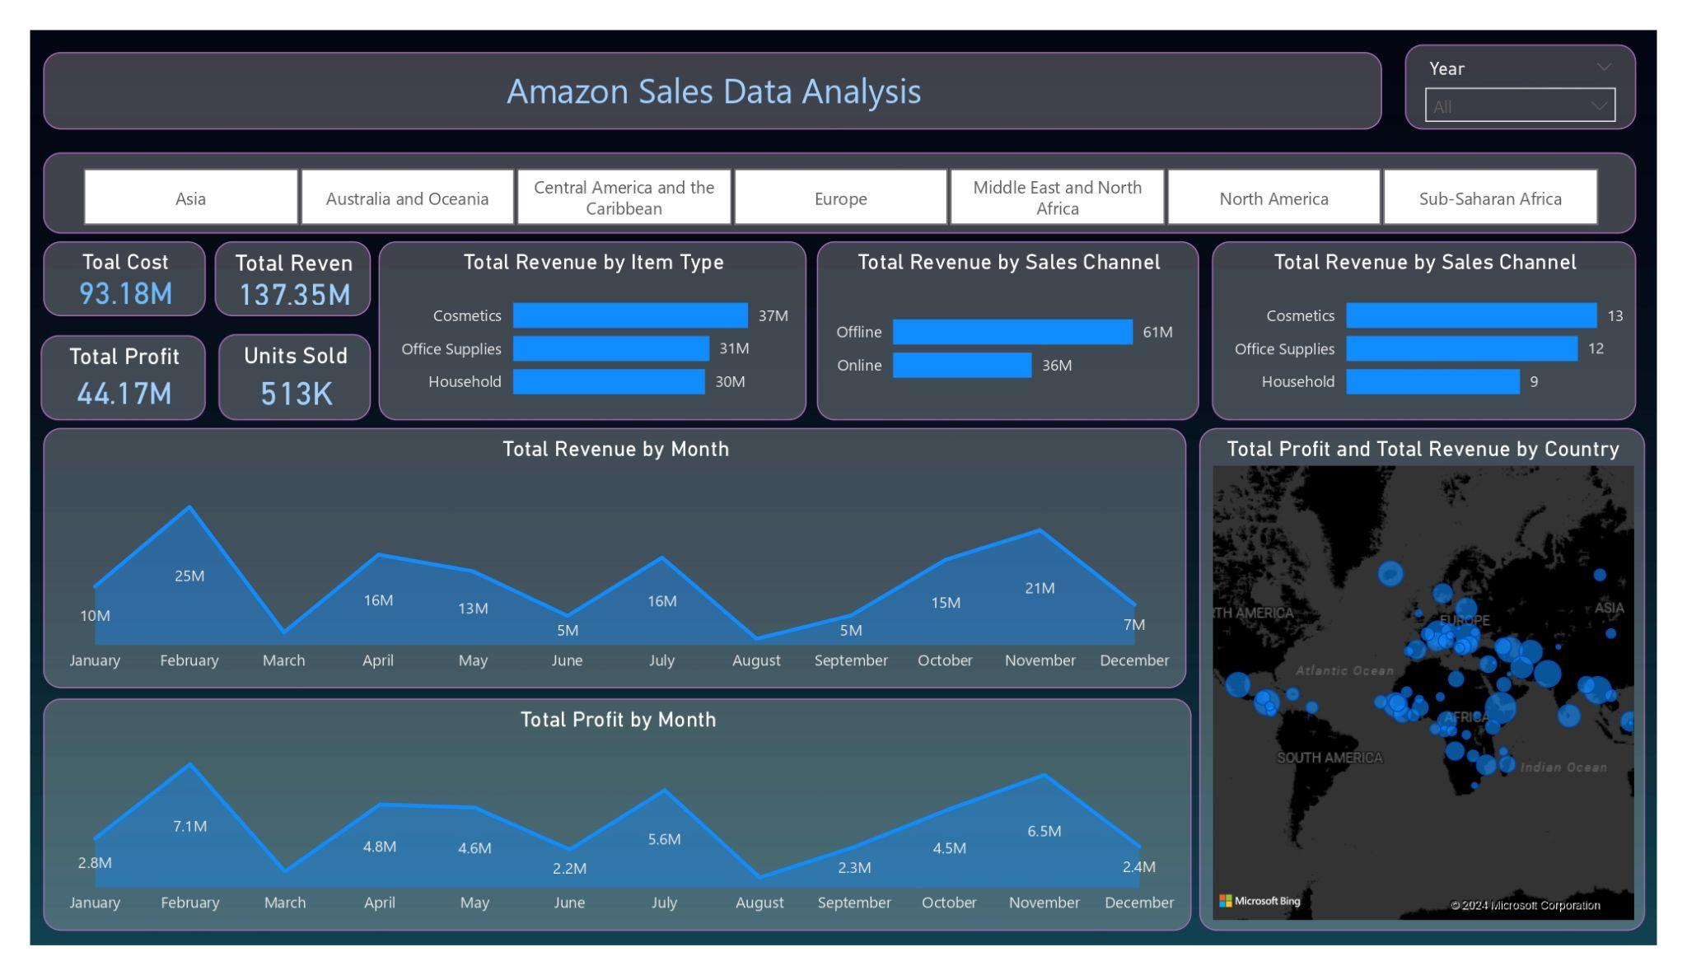
Graphical Representation Slide

Slide 7
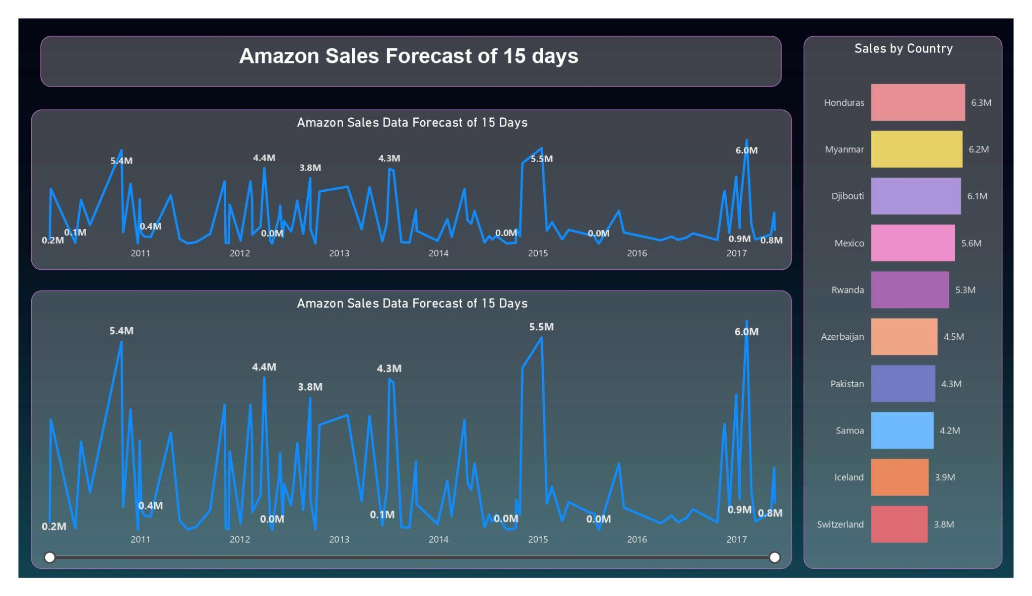
My Design

Slide 8
Conclusion
1. 2017 had the highest Revenue at 85.12M, followed by 2019 at 76.12 and 2018 at 20.36M​
​
2. If we observe the monthly insights of 2017,2018,2019, the sales are at their peak in March, June, and September and are low in April, May & October. Amazon can come up with some good discounts and offers to generate high revenue.​
​
3. The sales for the US are highest among all countries and lowest in Iran (IR).​
​
4. The Better Large Canned Shrimp & High Top Dried Mushrooms are the highest selling products in domestic and international markets. ​
​
5. Paracel Gigaplace & Pereras are the top customers who generated the highest revenue.​

Slide 9
Thank you

